Slide 1
Of Mice and Men

Slide 2
John Steinbeck (1902-1968)
Born & raised in Salinas, California.
Published nearly 30 novels.
His novels often deal with the simple aspects of life.
Of Mice and Men was first published in 1937.

Slide 3
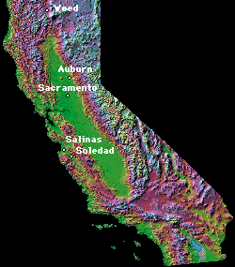
Setting
Takes place in southern California in the areas of Salinas and Soledad.
Soledad means solitude and loneliness in Spanish.
During the Great Depression
Nearing the end of the Dust Bowl.

Slide 4
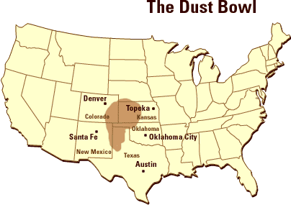

Slide 5
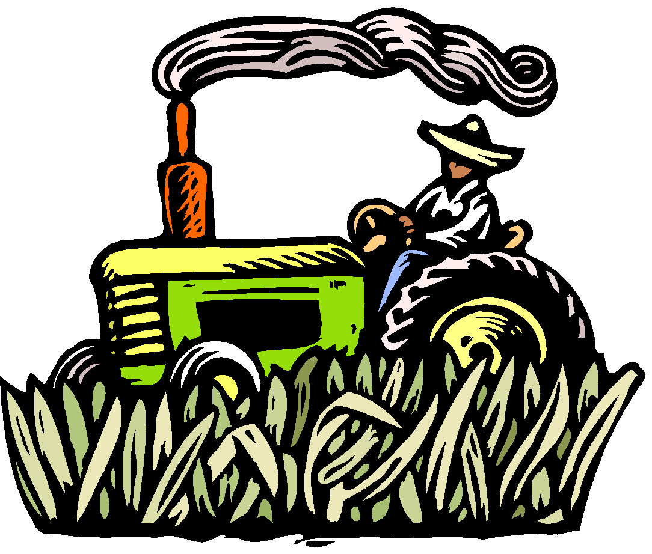
The Dust Bowl
Why it Happened…
Poor weather
Drought
Wind erosion of land
Over-farming
Introduction of the tractor
Time Period
Began early 1930’s
Great Depression
WWII Approaching

Slide 6
Images from The Dust Bowl
Photographs by Dorothea Lange

Slide 7
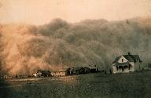
Dust approaching Spearman, Texas
Dust approaching Spearman, Texas

Slide 8
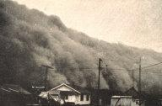
A dust storm approaching Stratford, TX.

Slide 9
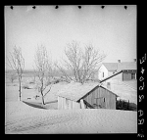
Dust Storm in Liberal, Kansas
.

Slide 10
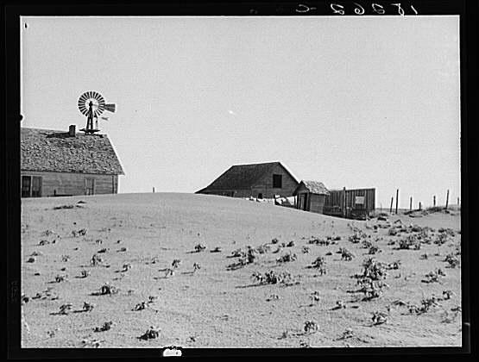
Farm Near Dalhart, Texas

Slide 11
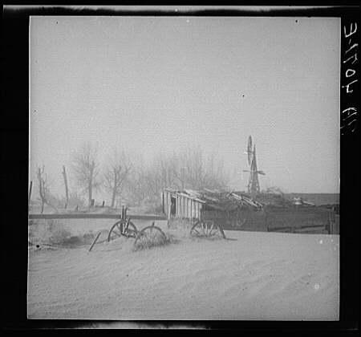
Dust Storm in Cimmaron, Oklahoma

Slide 12
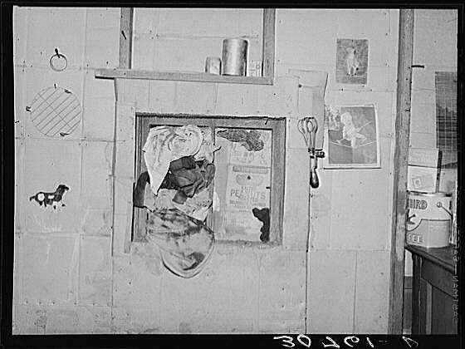
Window Stuffed with Rags

Slide 13
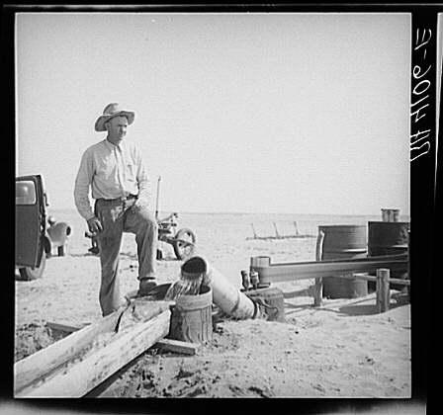
Oklahoma Farmer Irrigating the Land

Slide 14
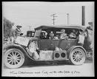
Oklahoma residents in San Fernando, California.

Slide 15
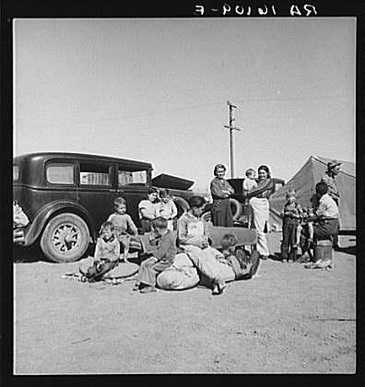
Roadside Camp in California

Slide 16
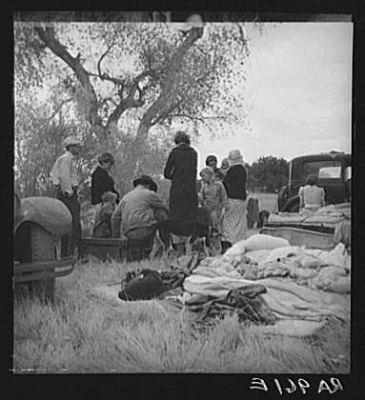
Squatters in Bakersfield,
California.

Slide 17
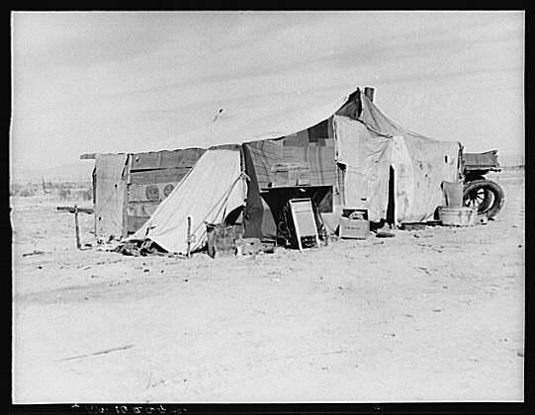
Home of a Dust Bowl Survivor in California

Slide 18
No Solution
People abandoned land.
Rumors of work in California.
Handbills
Distributed in affected areas
Advertised jobs
Promises of good pay
California became a “promised land.”

Slide 19
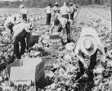
Migrant Farm Workers
Jobs were scarce.
Migrant farm workers roamed throughout the country looking for odd jobs on farms.
Our two main characters, George and Lennie, are migrant farm workers.

Slide 20
Life in the 1930’s
Popular Entertainment
Radio
Seeing a movie
Playing cards
Reading comic books
Food
Bread – 9 cents
Milk – 14 cents/qt.
Round steak – 42 cents/lb.
Life
Average life expectancy:
Man – 58.1 years
Woman – 61.6
Yearly Earnings
About $2,300
However, the average income dropped to $1,500.
25% of the nation’s work force is unemployed.

Slide 21
Plot and Characters
The events surrounding the complicated relationship between two friends, George and Lennie, who are migrant farm workers.
George and Lennie are both dependent on each other, but in different ways.

Slide 22
Literary Devices
Imagery – the use of vivid or figurative language to represent objects, actions, or ideas.
Animal Imagery (This is especially important to the character description of Lennie.)
Foreshadowing
Symbols

Slide 23
Literary Devices
Themes
Solitude and Loneliness
The American Dream
Friendship
Motifs – recurring structures, contrasts, or literary devices that can help to develop major themes
The Corrupting Power of Women
Discrimination
George’s solitaire game
The Predatory Nature of Human Existence

Slide 24
Use of Language – Idioms
Regional speech or dialect. A specialized vocabulary used by a group of people, jargon: legal idiom.
blow their stake
Lose and/or spend all their money
blowin' in our jack
losing, spending, or gambling away all our money
bustin' a gut
Your gut is your stomach area. To bust a gut is to engage in very hard physical labor -- so hard that you ache all over -- even in your gut.

Slide 25
More Idioms
bum steer
bum, in this instance, means false or erroneous. A bum steer is false information or directions.
canned
fired
jail bait
girl below the legal age of consent for sex; an underage girl who tempts a man to sexual intimacy which is punishable by imprisonment

Slide 26
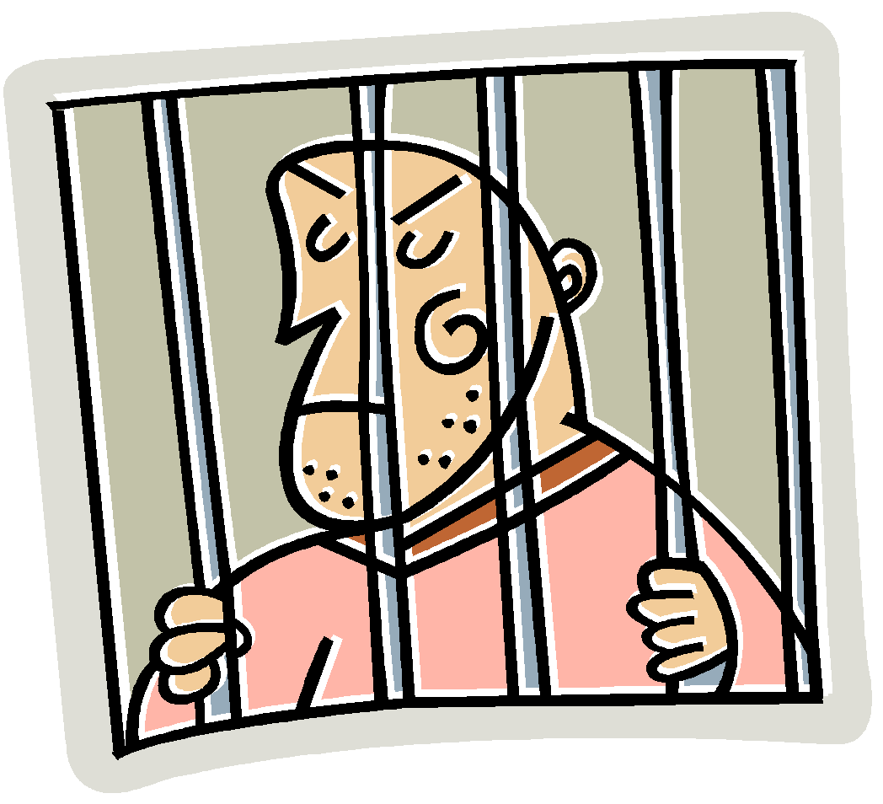
Even More Idioms
poop
energy; desire
rattrap
a hopeless situation; one that no good
can come from.
Hoosegow
jail

Slide 27
STILL Even More Idioms!!!
looloo
a sexy woman
roll up a stake
save up some money
wing-ding
a terrific person; someone to be admired
booby hatch
insane asylum; a place designed to house people who
are mentally unstable

Slide 28
Things to Consider
The style in which the novel is written.
Note that each chapter begins with a detailed description of the local setting, much like a scene in a play.

Slide 29
Essential Questions
What are the benefits of having relationships?
Are all relationships equal?
How do relationships support our lives?
What are the trade-offs in relationships?

Slide 30
Essential Questions
What determines the relationships we have?
How do class, religion, race, and culture determine our relationships?
What role does empathy play in mutual relationships?
What place does a dream/vision have in one’s life and relationships?

Slide 31
Relationships Exit Card
Answer the following questions on your note card using complete sentences. You will be turning the note card in as you exit the classroom.
What do relationships mean to you?
What kind of relationships do you observe in your life?
Why are relationships important or not important to you?

